Slide 1

DESIGN AND IMPLEMENTATION
OF NETWORKS
AAYUSHMAAN RAJEEV BAKSHI[RA2112703010006]
AYUSH KUMAR[RA2112703010007]
SUBHASHIS TRIPATHY[RA2112703010020]
AYUSH UPADHYAY[RA2112703010021] AKASH MUGILAN [RA2112703010023]

Slide 2
INTRODUCTION

Slide 3
This project aims to design and implement a network configuration that will allow the PCs in three different companies to communicate with each other as well as with all the PCs of any other company. The project will involve the following tasks:
1. Requirements Gathering: This pivotal step ensures a deep expertise of the specific desires and constraints of each entity. It includes quantifying the variety of PCs in every organisation, comprehending the nature of packages to be supported, and defining protection conditions.
2. Design of Network: With an intensive grasp of the distinctive necessities of every agency, the task advances to the network layout phase. Here, a network topology is meticulously crafted to harmonize the wishes of all three corporations.

Slide 4
3. Implementation of Network: This vital step entails the bodily set up of networking hardware and software program. The configuration of community devices is undertaken with precision, and a complete trying out regime is executed to make certain the community's seamless functionality.
4. Documentation of Network: The final step will be to document the network configuration. This documentation will include diagrams of the network topology, configuration settings for the network devices, and instructions on how to troubleshoot network problems.

Slide 5
AIM

Slide 6
The aim of this project is to design a cost-effective, efficient, and scalable network infrastructure that enables seamless communication within and between three companies (CMP X, CMP Y, CMP Z) while minimizing hardware costs and adhering to specified constraints.

Slide 7
APPARATUS REQUIRED

Slide 8
The apparatus required for the network configuration project includes:
1. Cisco Packet Tracer
2. Routers
3. Switches
4. PCs
5. Ethernet Cables
6. Serial DCE Cables
7. IP Addressing Scheme
8. Documentation Tools
These components are essential for designing and configuring the network for CMP X, CMP Y, and CMP Z while considering the specified constraints.

Slide 9
PROBLEM STATEMENT

Slide 10
Suppose that you are the CEO of a startup which deals with network configuration for various companies. After 100 days of struggle, you have finally received your first assignment to configure the network for three different companies in such a way that all the PCs in each company must be able to communicate with each other as well as with all the PCs of any other company

Slide 11
CONSTRAINTS

Slide 12
You, being very cautious, decide to simulate the topology on Cisco Packet Tracer in order to optimally design the network considering the number of devices (switches, routers etc.) used to maximize the profit margins of your company. However, you must simulate the topology strictly following rules and regulations described below:
Use Straight Through wires, Cross Over cables or Serial DCE wires where necessary and applicable.
Use Generic Router and Generic PCs for your design
Use Generic Switches such that you attach only 3 of the 4 available Ethernet Interfaces for a single switch, however, you can attach as many switches considering optimal design.
You have to assign IPs to the PCs using Static IP allocation.
Although you have to use GUI of the router to configure its interfaces but you must use CLI of the router to configure the RIPv2 Protocol for Classless Subnet Addressing.

Slide 13
CAMPUS DIAGRAM

Slide 14
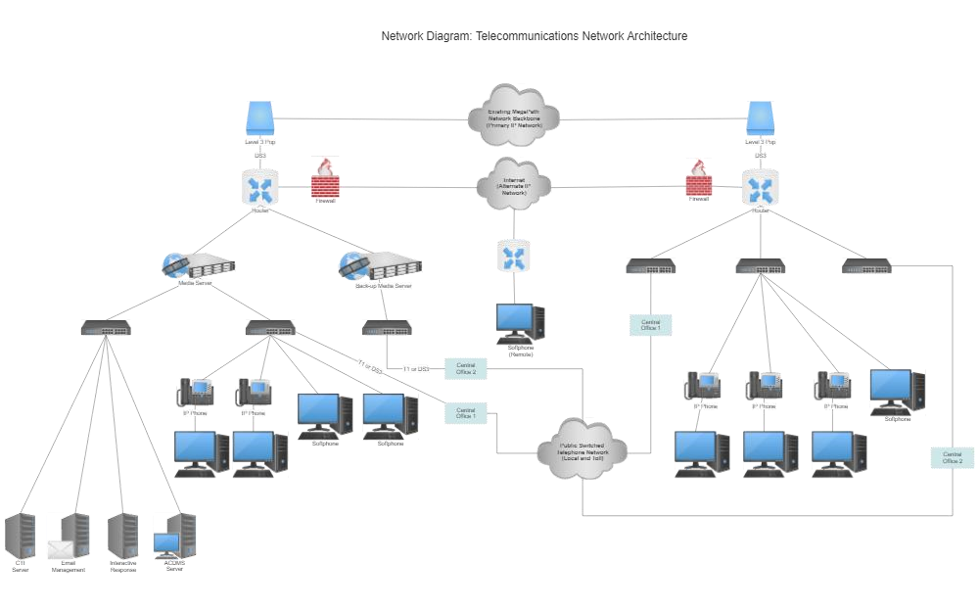

Slide 15
ALGORITHM

Slide 16
Algorithm for Designing the Network:
Determine the Number of Subnets:
Calculate the range of subnets wanted for every corporation based on the range of rooms and PCs in every room.
CMP X: five rooms,
CMP Y: three rooms,
CMP Z: 2 rooms.
Subnetting the Assigned IP Addresses:
Subnet the assigned IP network addresses for each corporation the use of the perfect subnet mask. Ensure that every room within a organization is at the same subnet. Calculate the subnet masks for every agency based totally on the wide variety of rooms.
IP Address Assignment:
Assign static IP addresses to each PC within a subnet. Ensure that each one PCs within the equal room have consecutive IP addresses. Use the subnet ID and the position of the PC in the room to decide the IP deal with for each PC.
Router Placement: Determine the number of routers required for inter-company conversation. You need to reduce the range of routers used. Ensure that routers are strategically located to connect the subnets of different corporations.

Slide 17
Router Configuration:
Use the GUI of the router to configure its interfaces. Assign IP addresses to the router interfaces to attach the subnets. Configure RIPv2 the use of the router's CLI for classless subnet addressing to allow dynamic routing.
Switch Placement:
Place switches in each room to connect the PCs. Use well-known switches with 3 operating Ethernet ports.
Wiring and Connectivity:
Use directly-via wires to attach PCs to switches and crossover cables to attach switches to routers. Ensure that each room's PCs are related to the same transfer. Connect switches to routers as wished for inter-business enterprise and intra-organization verbal exchange.
Serial Communication Network:
Use the supplied serial communique network deal with (199.210.121.160/28) for connecting the routers. Each router's serial interface must be configured with an IP deal with from this range.

Slide 18
PROCEDURE

Slide 19
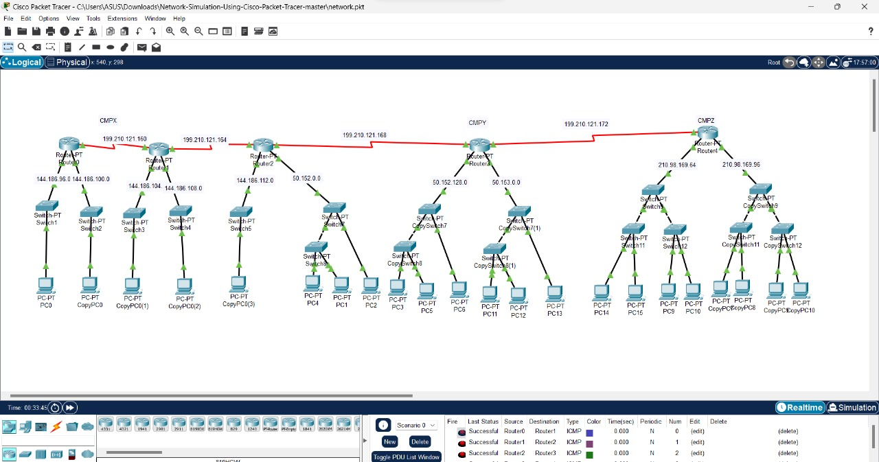
Topology Design:
Design the network topology considering the following principles:
Ensure that all PCs within the same room belong to the same subnetwork.
Establish separate subnetworks for each company.
Minimize the use of routers and switches to optimize cost while maintaining efficient communication.
Plan for future scalability, considering the anticipated increase in the number of PCs in each room.

Slide 20
Hardware Selection and Setup:
Given the cost-conscious approach, select the appropriate hardware components. Utilize old switches with three active Ethernet ports out of four and generic routers to interconnect the PCs effectively.
Router-PT
Switch-PT
PC-PT
Copper-Straight Through Wire
Copper-Cross Over Wire
4 Serial-DTE Wire

Slide 21
Subnetting:
CMP X: Subnet the provided IP address 144.186.96.0/19 to create subnets for each room. There are 5 rooms with 1 PC in each room, so you need at least 5 subnets.
Room 1: 144.186.96.0/24
Room 2: 144.186.97.0/24
Room 3: 144.186.98.0/24
Room 4: 144.186.99.0/24
Room 5: 144.186.100.0/24
CMP Y: Subnet the provided IP address 50.152.0.0/15 to create subnets for each room. There are 3 rooms with 3 PCs in each room, so you need at least 3 subnets.
Room 1: 50.152.0.0/26
Room 2: 50.152.0.64/26
Room 3: 50.152.0.128/26
CMP Z: Subnet the provided IP address 210.98.169.64/26 to create subnets for each room. There are 2 rooms with 4 PCs in each room, so you need at least 2 subnets.
Room 1: 210.98.169.64/28
Room 2: 210.98.169.80/28

Slide 22
Interconnecting the Companies:
To allow communication between PCs of different companies, you need routers to route traffic between their subnets.
Connect a router to each company's subnets.
Use the provided IP address
199.210.121.160/28 to connect the routers. Assign IP addresses to the router interfaces accordingly.

Slide 23
Intra-Company Communication:
For communication within a company, you can use switches to connect PCs in the same room. You mentioned using old switches with 3 working Ethernet ports, so you'll need multiple switches in each company.
In CMP X, each room (subnet) connects to a separate switch. Each switch should have three PCs connected.
In CMP Y, each room (subnet) connects to a separate switch. Each switch should have three PCs connected.
In CMP Z, each room (subnet) connects to a separate switch. Each switch should have three PCs connected.

Slide 24
Router Configuration:
To configure RIPv2 for Classless Subnet Addressing, use the Command Line Interface (CLI) of the routers. Configure RIP on the router interfaces connected to each company's subnets. Make sure to advertise the subnets within the respective companies.

Slide 25
Testing:
After setting up the network, test the communication between PCs within each room, between rooms within the same company, and between rooms in different companies. Ensure that the routers are routing traffic between subnets correctly. Optimize the network for performance, addressing any issues that arise during testing.

Slide 26
Scalability:
As each company plans to extend the number of PCs in each room in the future, make sure your design allows for scalability. You can easily add more switches for additional rooms and PCs within the same subnet. If the number of subnets grows, you might need additional routers.

Slide 27
Documentation:
Document the IP addresses assigned to each PC, router, and switch port for reference and troubleshooting. This documentation will include diagrams of the network topology, configuration settings for the network devices, and instructions on how to troubleshoot network problems.

Slide 28
NETWORK COMPONENTS

Slide 29
Components:
5 Router-PT
17 Switch-PT
22 PC-PT
32 Copper-Straight Through Wire
7 Copper-Cross Over Wire
4 Serial-DTE Wire

Slide 30
IMPLEMENTATION

Slide 31
1. Open Packet Tracer.
2. Add the following devices to the workspace:
2 routers
3 switches
6 PCs
3. Connect the devices as shown in the diagram, using the appropriate cables.
4. Configure the IP addresses and subnet masks for all devices, as shown in the diagram.
Configuring the routers:
Router 1
interface FastEthernet0/0
ip address 199.210.121.160 255.255.255.0
interface FastEthernet0/1
ip address 144.186.104.14 255.255.255.0
router rip

Slide 32
Router 2
interface FastEthernet0/0
ip address 199.210.121.172 255.255.255.0
interface FastEthernet0/1
ip address 144.186.112.1 255.255.255.0
router rip
Configuring the switches:
Switch 1
interface GigabitEthernet0/1
switchport mode access
vlan 10

Slide 33
interface GigabitEthernet0/2
switchport mode access
vlan 20
interface GigabitEthernet0/3
switchport mode access
vlan 30
Switch 2
interface GigabitEthernet0/1
switchport mode access
vlan 10
interface GigabitEthernet0/2
switchport mode access
vlan 20

Slide 34
interface GigabitEthernet0/3
switchport mode access
vlan 30
Switch 3
interface GigabitEthernet0/1
switchport mode trunk
encapsulation dot1q
trunk allowed vlan 10,20,30
interface GigabitEthernet0/2
switchport mode access
vlan 10

Slide 35
interface GigabitEthernet0/3
switchport mode access
vlan 20
Configuring the PCs:
PC 1
ip address 199.210.121.161 255.255.255.0
gateway 199.210.121.160
PC 2
ip address 199.210.121.162 255.255.255.0
gateway 199.210.121.160
PC 3
ip address 199.210.121.163 255.255.255.0
gateway 199.210.121.160

Slide 36
PC 4
ip address 144.186.104.15 255.255.255.0
gateway 144.186.104.14
PC 5
ip address 144.186.104.16 255.255.255.0
gateway 144.186.104.14
PC 6
ip address 144.186.112.2 255.255.255.0
gateway 144.186.112.1
Once all devices are configured, you can test the network connectivity by pinging between different devices. For example, you can ping from PC 1 to PC 4, or from PC 3 to PC 6.

Slide 37
NETWORK DESIGN

Slide 39
SIMULATION DIAGRAM

Slide 40
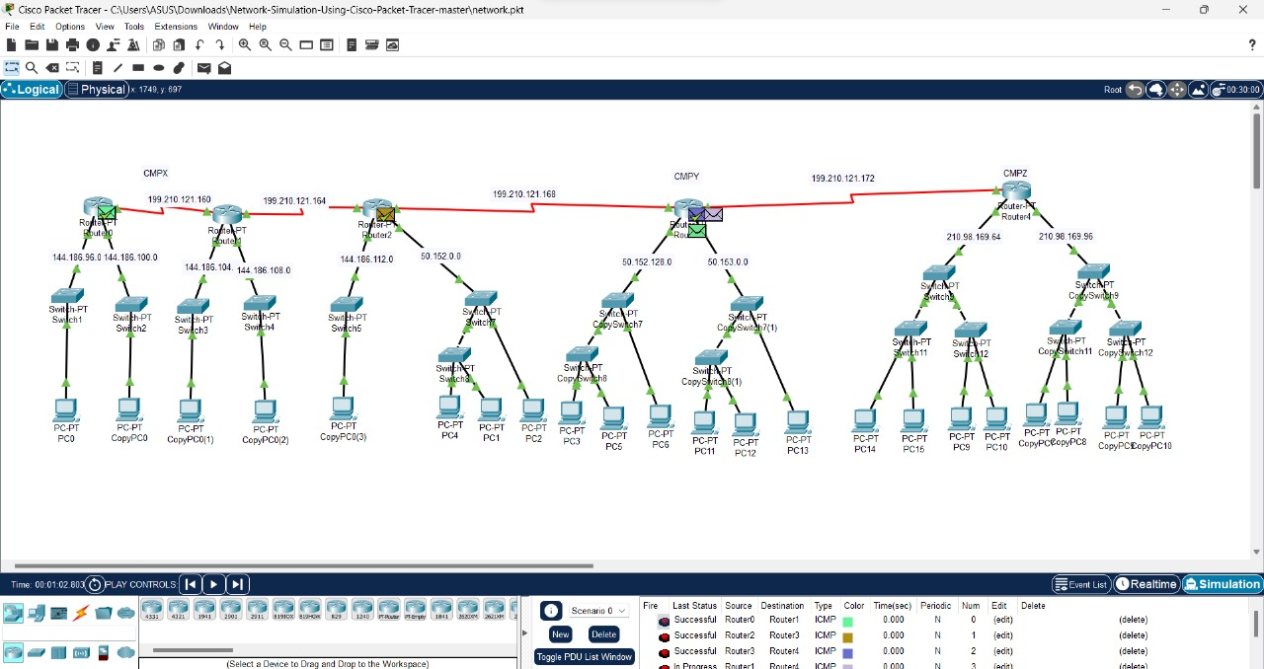

Slide 41
FUTURE SCOPE

Slide 42
As technology develops, the field of intercompany network design and implementation becomes more and more exciting. The growing trend in this industry is the adoption of cloud computing. Cloud-based solutions provide scalability, adaptability, and cost-effectiveness as benefits for integrating intercompany networks.Additionally, cutting edge network technologies like network function virtualization and software defined networking are becoming more and more popular. These developments can.For intercompany network integration projects, automating network administration is highly beneficial.The Internet of Things and the proliferation of gadgets bring opportunities as well as challenges. Building networks that can handle the ever-growing number of devices and Internet of Things devices is imperative for organizations as it paves the way for future intercompany network design and implementation.

Slide 43
CONCLUSION

Slide 44
As technology develops, the field of intercompany network design and implementation becomes more and more exciting. The growing trend in this industry is the adoption of cloud computing. Cloud-based solutions provide scalability, adaptability, and cost-effectiveness as benefits for integrating intercompany networks. Additionally, cutting edge network technologies like network function virtualization and software defined networking are becoming more and more popular. These developments can. For intercompany network integration projects, automating network administration is highly beneficial. The Internet of Things and the proliferation of gadgets bring opportunities as well as challenges. Building networks that can handle the ever-growing number of devices and Internet of Things devices is imperative for organizations as it paves the way for future intercompany network design and implementation.

Slide 45
THANK YOU

